Slide 1
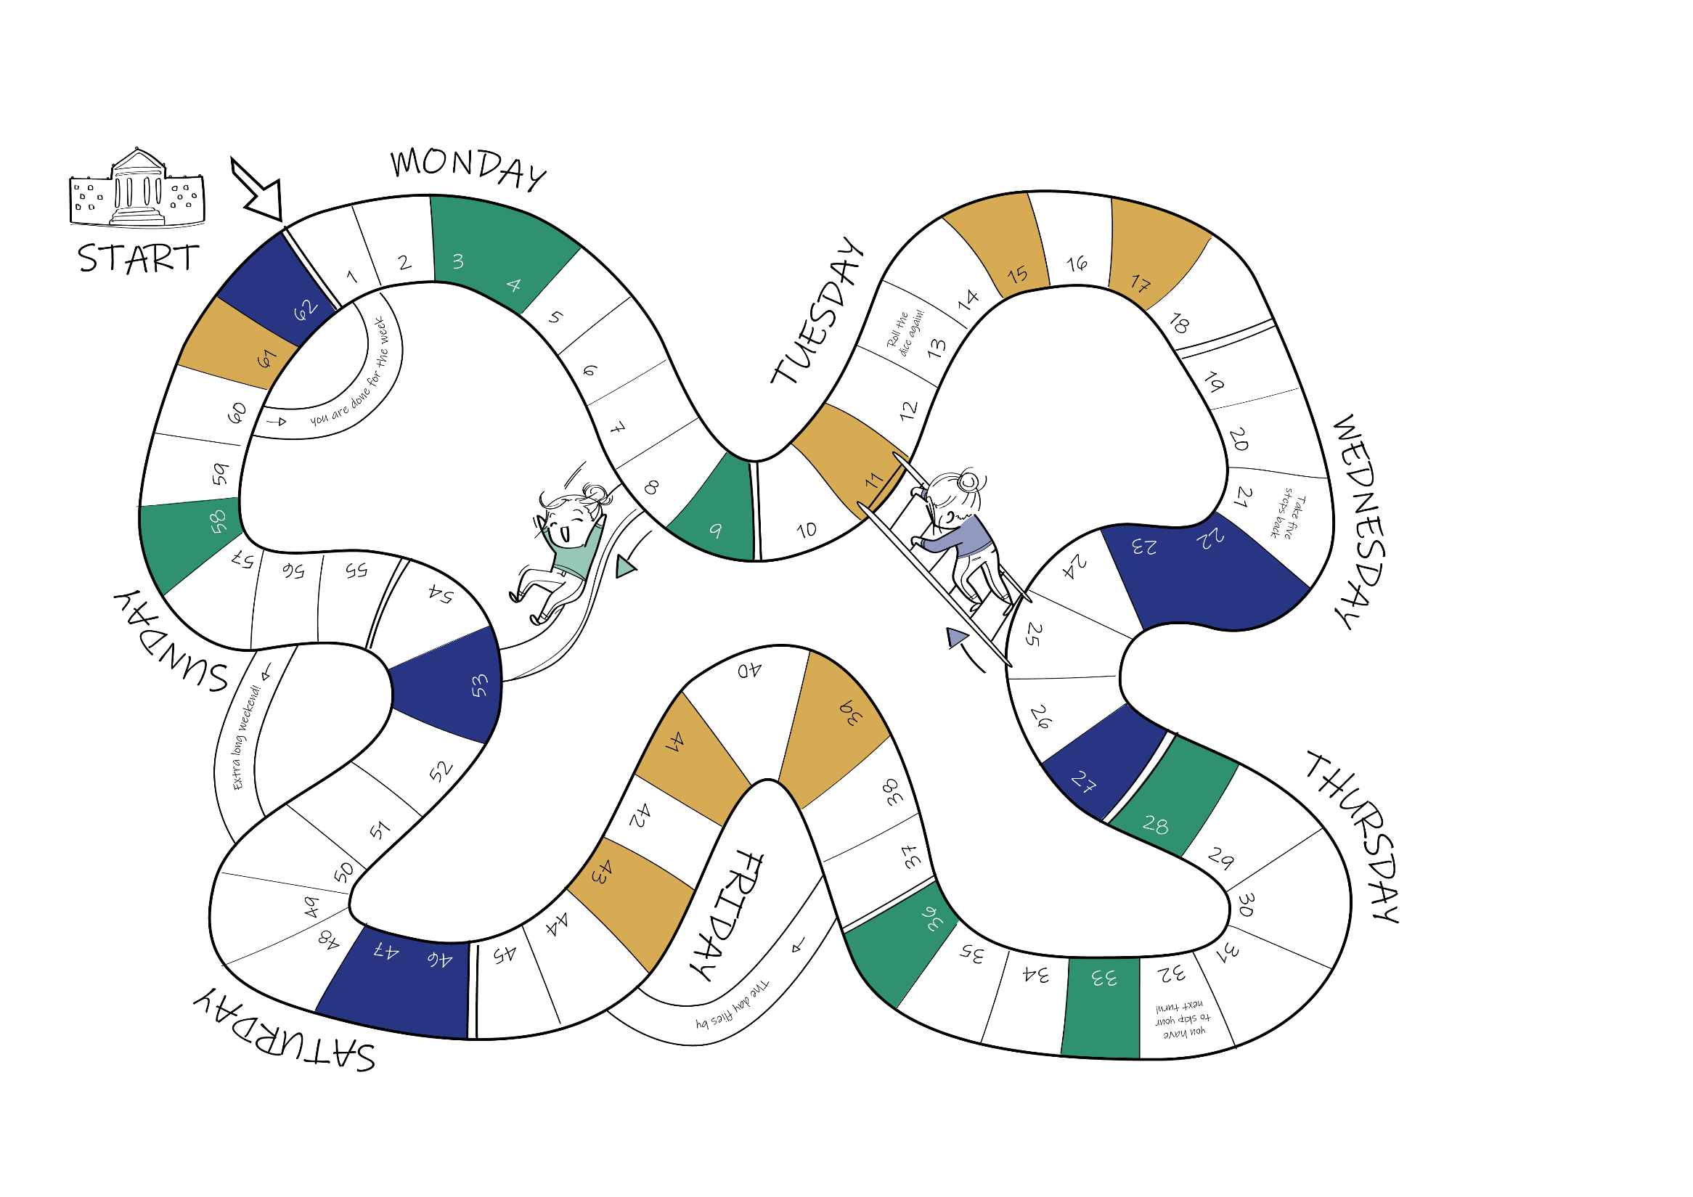
Faculty of Behavioural
and Social Sciences
Teacher Education,
Higher Education
How to Promote University Students’ Well-being and Resilience.
Testing a Game-Approach Basic Psychological Need Intervention in Dutch Higher Education
Lisa Kiltz, Marjon Fokkens-Bruinsma, Ellen P. W. A. Jansen

Slide 2
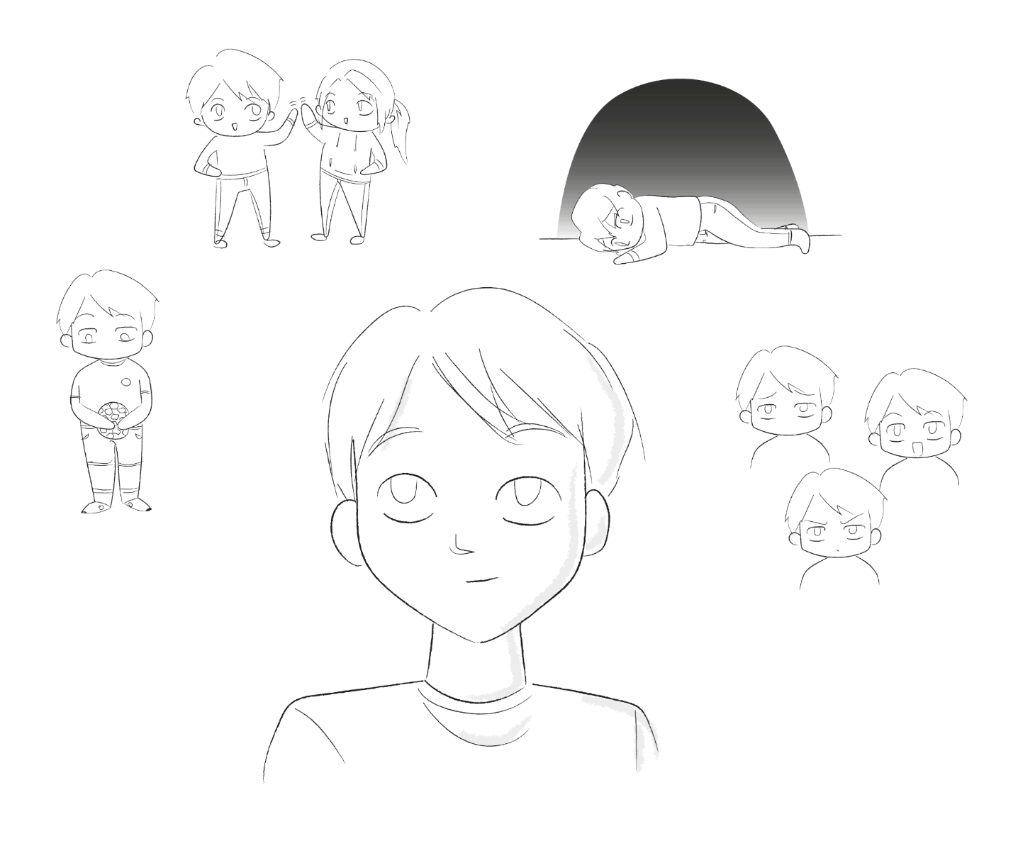
Theoretical Framework
Well-being defined by an accumulation of sub-facets; presence of well-being and not merely absence of ill-being
Resilience defined as the capacity to mobilise resources to face adversities and bounce back to the original psychological state
Student well-being appears to be a critical issue in academia (e.g., Bewick et al., 2010; Cooke et al., 2006; Stallman, 2010)
Resilience as individual resource for well-being (e.g., Denovan & Macaskill, 2017; Wu et al., 2020)
Notes:
Poor student well-being is associated with lower, good student well-being with higher academic performance

Slide 3
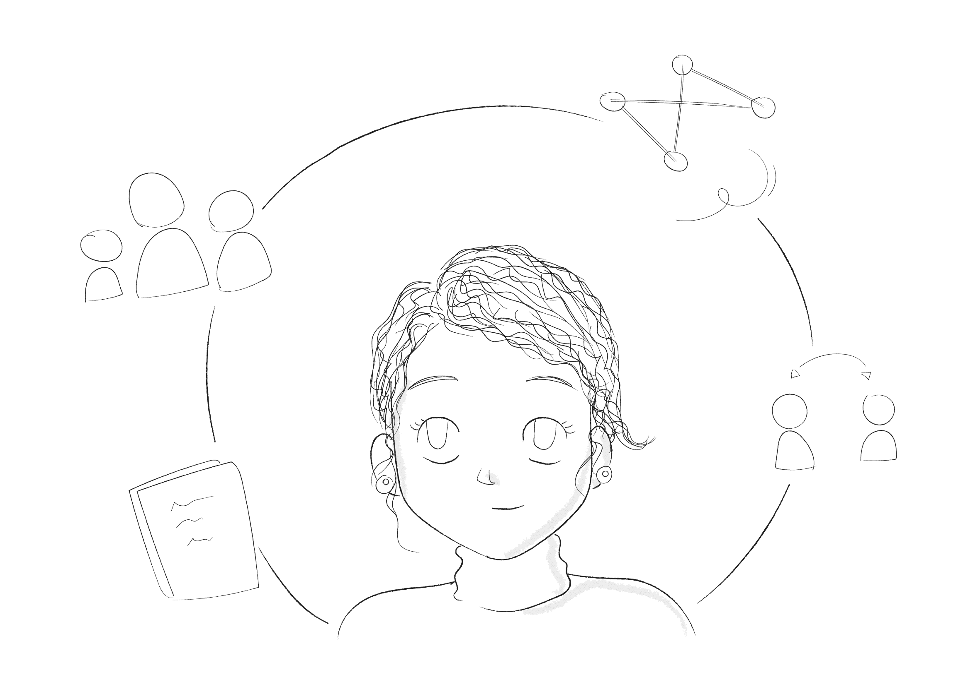
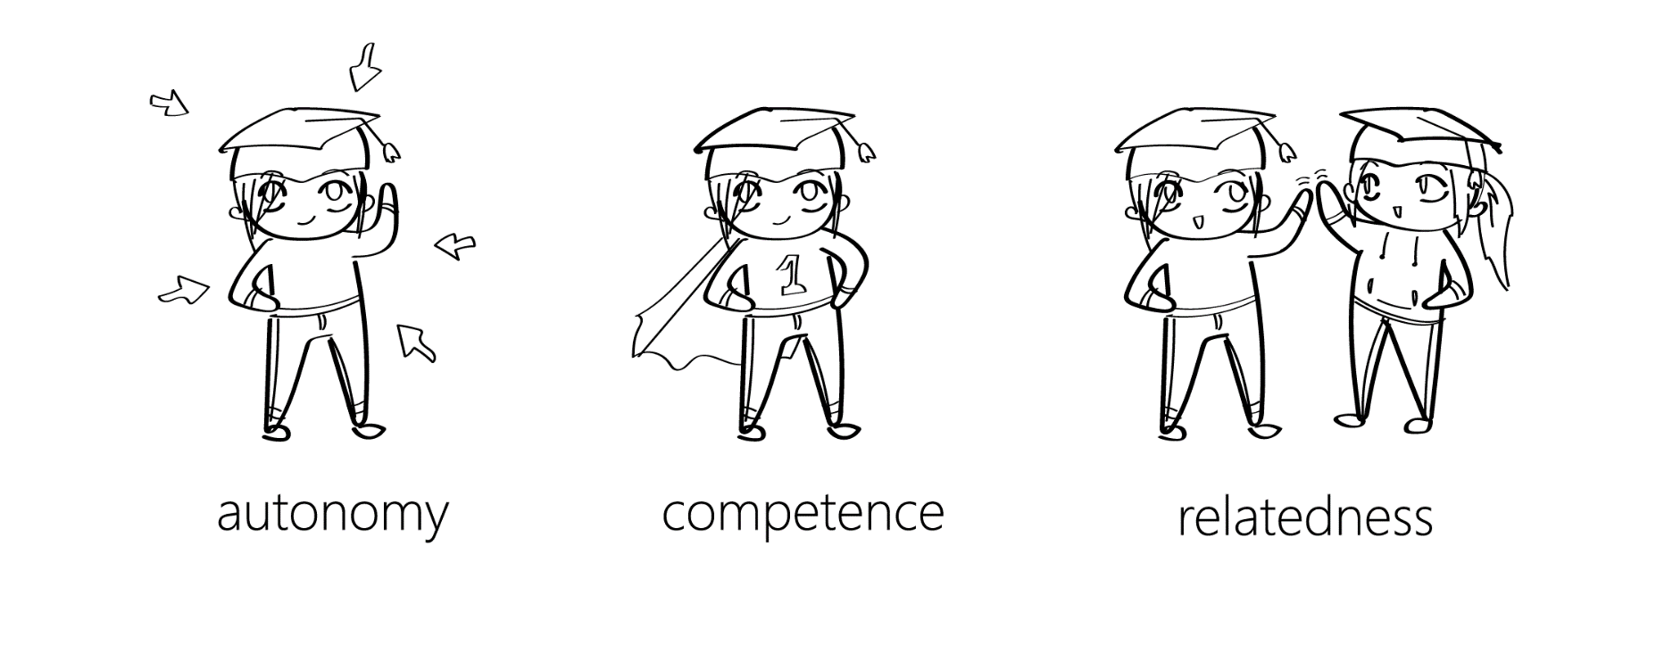
Theoretical Framework
Most interventions keep to an individual level (e.g., Akeman et al., 2020; Lanz, 2020), whereas systemic interventions (such as Larcombe et al., 2015; Baik et al., 2017) remain scarce
Self-Determination Theory & basic psychological needs (Deci & Ryan, 1985)
Notes:
SDT = well-being theory, give examples for BPN

Slide 4
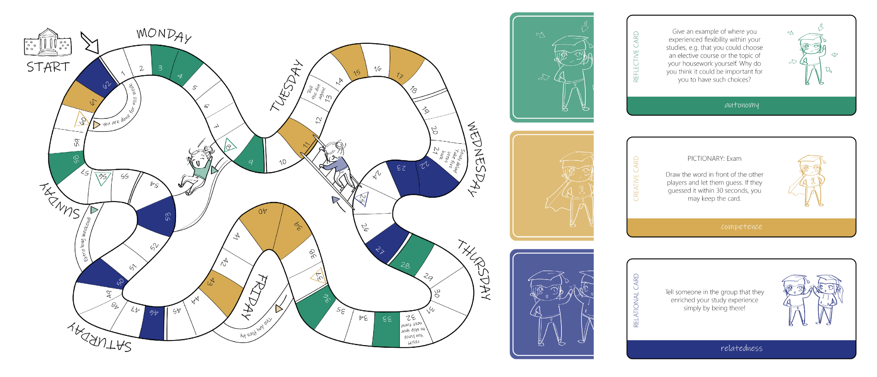
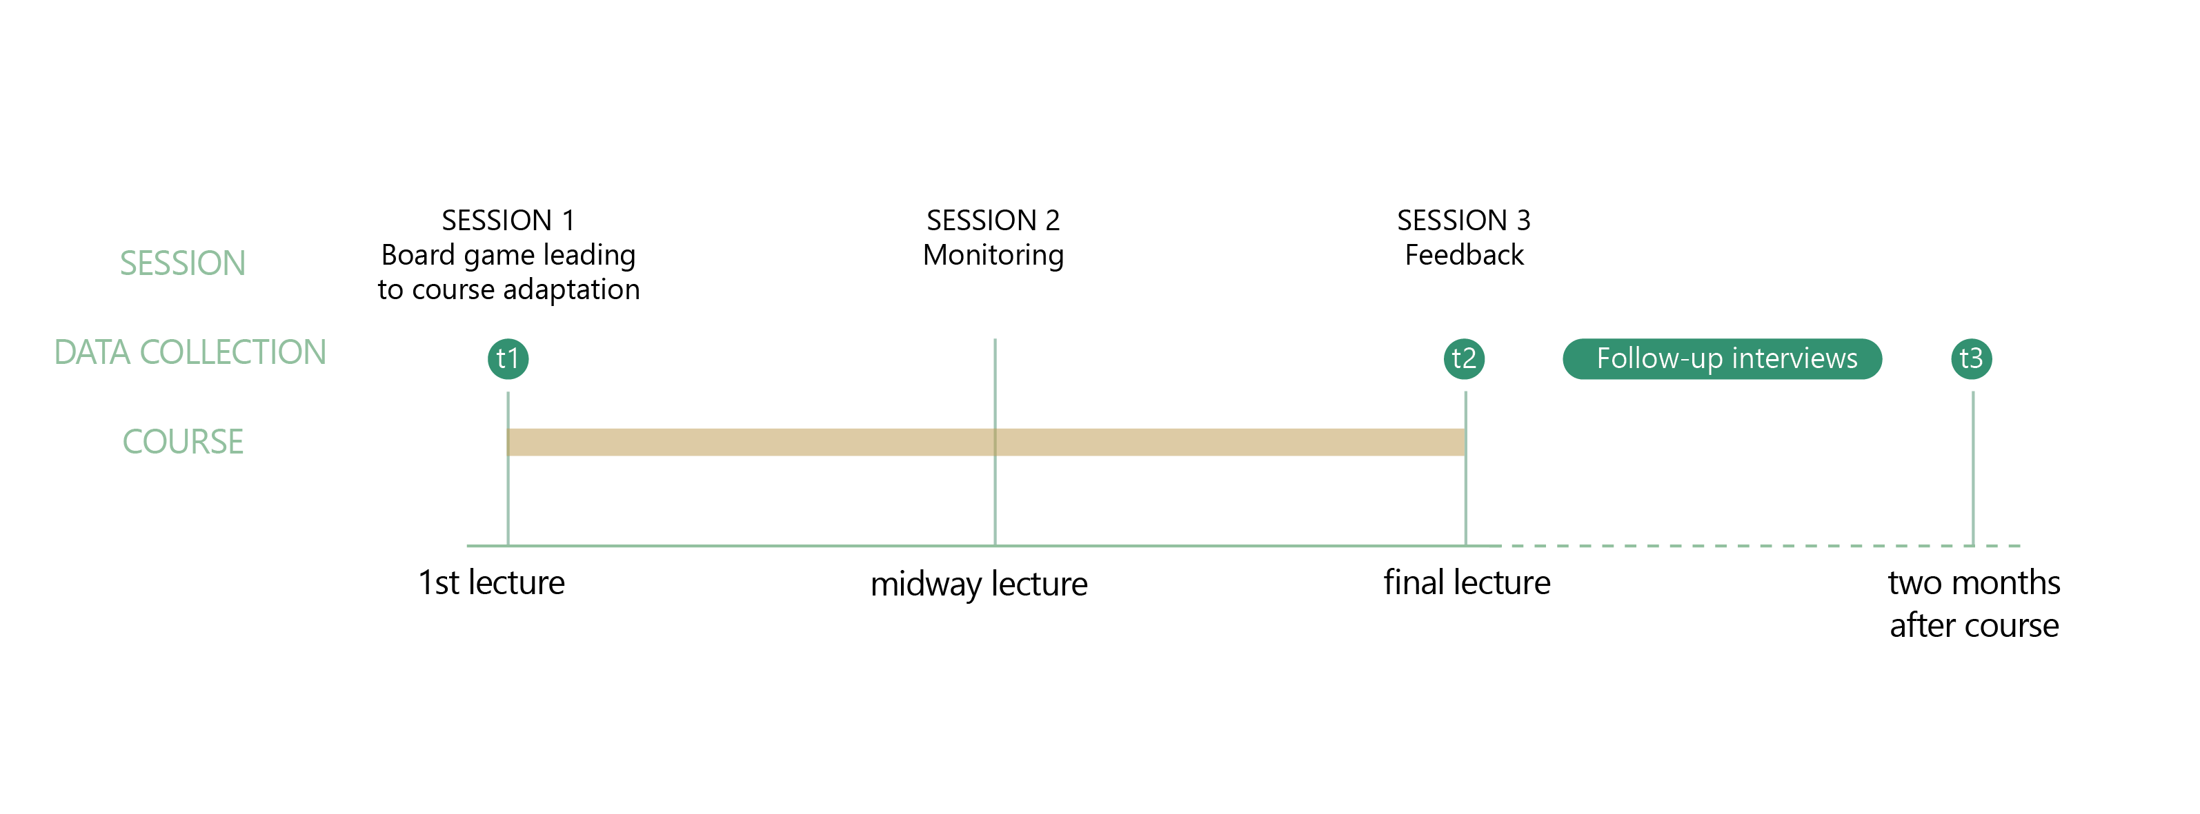
The intervention
Notes:
Not too much detail

Slide 5
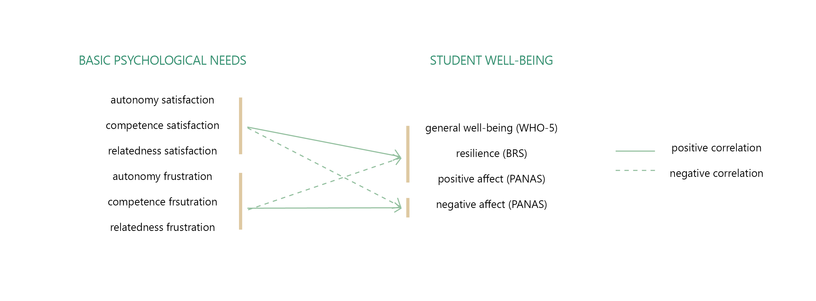
Research Questions
RQ.1 How effective is the intervention in promoting students’ well-being and resilience above aspects already present in the course manual that promote need satisfaction independently from the intervention?
RQ.2 How do teachers and students experience the intervention regarding its potential to promote student well-being?
Notes:
Take more time to explain measures
H1. BPN as predictors, H2. interaction effect, H3. also longitudinal

Slide 6
Method
Experimental course (n t1 = 41, n t2 = 20, n t3 = 11)
1st year Bachelor course, spatial sciences
44% female, 54% male, 2% agender/non-binary
17-23 years old (M = 19.5, SD = 0.2)
44% international, 24% first-generation
Control course (n t1 = 38, n t2 = 19, n t3 = 8)
1st year Bachelor course, spatial sciences
34% female, 61% male, 5% agender/non-binary
18-33 years old (M = 19.7, SD = 0.5)
45% international, 24% first-generation
Notes:
Originally planned three courses plus control courses…

Slide 7
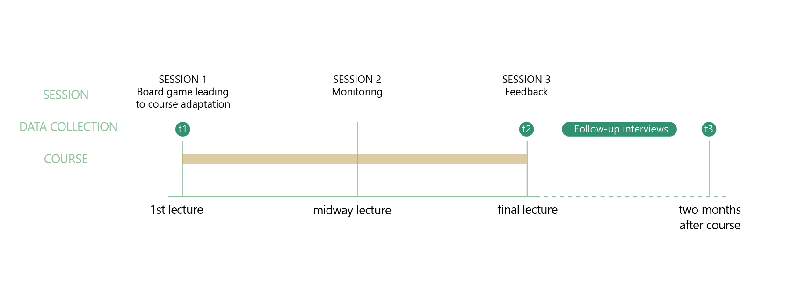
Method
Observational data
during the sessions; poll with mentimeter© or poll everywhere© & subsequent discussion
Survey data
longitudinal with three points of measurement
Well-being: WHO-5 (World Health Organization, 1998), PANAS (Watson et al., 1988)
Resilience: BRS (Smith et al., 2008)
BPN: BPNSNF (Chen et al., 2015)
Interview data
Focus group students (n = 2)
Interview with teachers (n = 2)
Notes:
Only two students in focus group…

Slide 8
Method
Analysis
Observational data: descriptive
Survey data: correlations, multiple regression, MANOVA, descriptive
Interview data: descriptive
Notes:
Too little qualitative data for more in-depth analysis
Two multiple regression, first one control variables, second one entering the BPN

Slide 9
Results
Student’s suggestions for the course:
have as much time between teachers and students to discuss material and lectures
Discussion from everyone's perspectives, experiences and backgrounds (when working in a group)
Autonomy to make as many decisions in regard to the course yourself (e.g. self-enrollment for groups)
Notes:
Adjustments: group forming process, vote for online/offline, active discussion (flipped classroom)

Slide 10
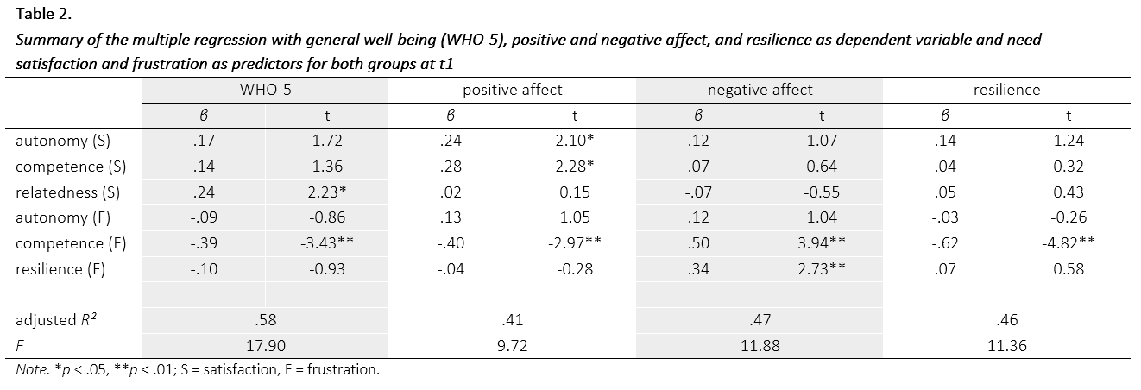
Results
Basic psychological needs as predictors
Notes:
WHO & positive affect -> BPN satisfaction, negative affect -> BPN frustration; strongest predictor competence frustration across all

Slide 11
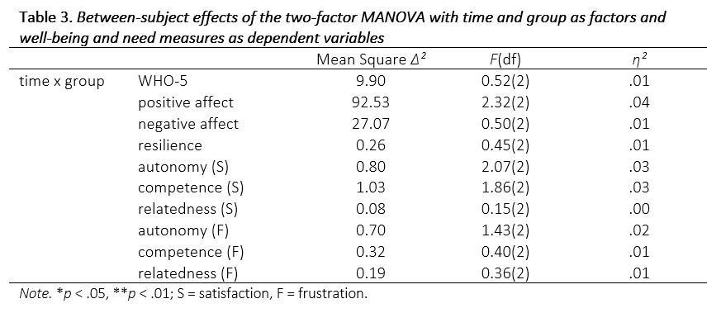
Results
Group differences
Notes:
Competence & relatedness satisfaction, WHO & neg affect -> group differences
The tendencies are in the hypothesized direction

Slide 12
Results
Students’ and teachers’ experiences:
[I liked the] assignments and the amount of input we were allowed to make. I also enjoyed that [the teacher] made an effort to create personal connections between students.
We opened [ourselves] for
the first time with my friends for the board game. The discussion in class are amazing.
I am not totally sure if it had any real impact and if it would not have been the same without the intervention.

Slide 13
Discussion
The intervention’s effectiveness
Could not be proven quantitatively, but observational and qualitative data hint towards its effect nonetheless
Practical implications
Systemic interventions including students’ surroundings can and should be an option
Further advancements of this or other interventions
Limitations
Context- and time-specific
Issues with set-up and implementation
Notes:
Issues: courses dropping out, no interview participation, should have been directly after board game

Slide 14
Take-home message
Students’ well-being cannot only be promoted by teaching them how to be better, but by teaching us how to create a healthier environment
Research hardly ever works as planned ;)

Slide 15
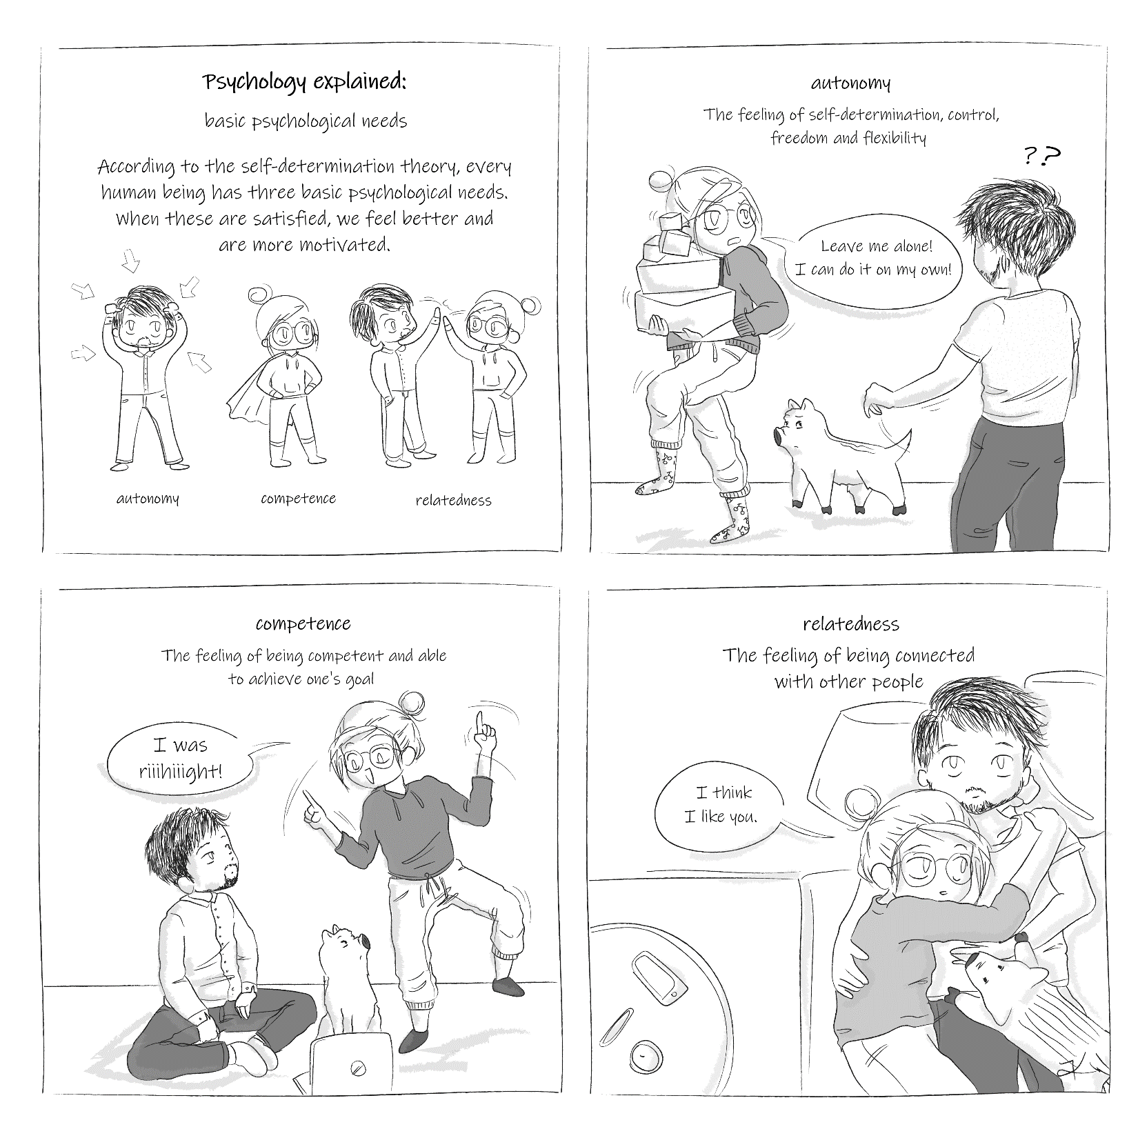
Thanks to…
University of Groningen / UMCG
Marjon Fokkens-Bruinsma
Ellen P. W. A. Jansen
faculty of behavioural
and social sciences
higher education

Slide 16
Questions…?
More information at
Twitter @KiltzLisa or @floreraar
Instagram @lis.lito
https://thrive.gmw.rug.nl/

