Slide 1
University of Groningen Lisa Kiltz, Marjon Fokkens-Bruinsma, Ellen P.W.A. Jansen
University of Augsburg Raven Rinas, Martin Daumiller
”If They Struggle I Cannot Sleep Well Either”: Perceptions and Interactions Surrounding University Student and Teacher Well-Being

Slide 2
Research Problem
University students’ well-being
  face elevated levels of distress, mental health problems, and burnout Benbassat (2014); Bewick et al. (2010); Cooke et al. (2006); Dyrbye & Shanafelt (2016), Larcombe et al. (2016); Stallman (2010); Wierenga, Landstedt, & Wyn (2013)
  engagement as well as positive sense of well-being increases academic performance Panger, Tryon, & Smith (2014);
  Stanton et al. (2016); Schaufeli et al. (2002)
1
University teachers’ well-being
  At-risk for compromised well-being: mental health problems(burnout, stress), role-conflict, ambiguity, low work-life balance Flaxman, Menard, Bond, & Kinman (2012); Hogan, Hogan, & Hodgins (2016); Padilla & Thompson (2016); Watts & Robertson (2011); Winefield et al., (2008)
2
Notes:
Students: Increase in academic distress throughout time & decrease in student well-being
Teachers: positive side less well researched

Slide 3
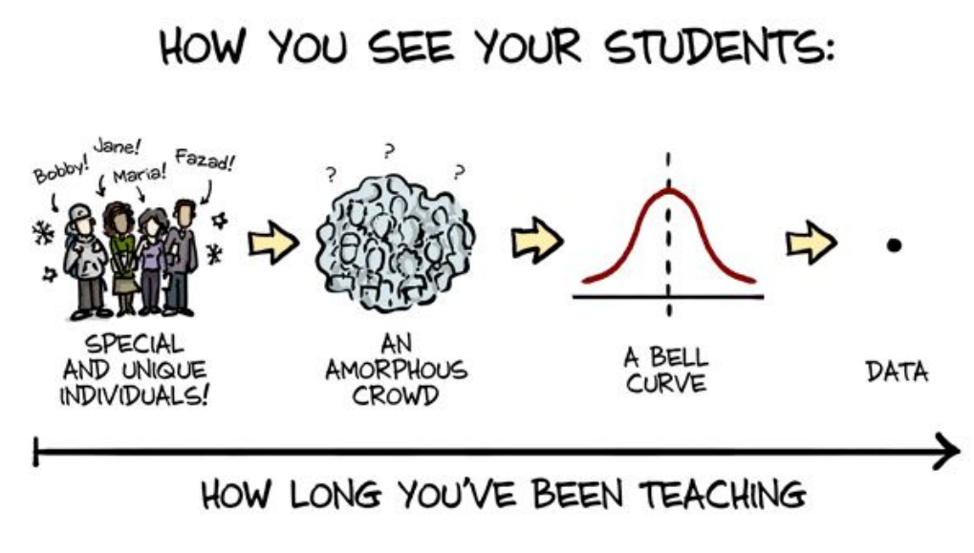
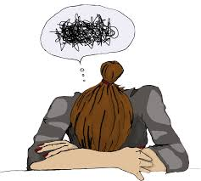
Research Problem
University teachers’ and students’ well-being researched in isolation from one another
  Evidence of well-being interaction Hagenauer & Volet (2014a, 2014b); Lundberg & Schreiner (2004); Kordts-Freudinger (2017); Postareff & Sari Lindblom-Ylänne (2011);
  Strauss & Volkwein (2004); Trigwell (2012); Zepke & Leach (2010)
3
Notes:
Relations between teaching practices and student learning
Student engagement as source of teachers’ emotions and impact on teaching practices
Importance of the student-teacher relationship: university teachers contribute to student commitment, effort, and motivation

Slide 4

Theoretical Background
Positive Psychology
  Focus is not restricted to absence of ill-being, but also on presence of well-being Seligman and Csikszentmihalyi (2000, p.5), WHO (2020)
Resilience
  An individual’s ability to face negative experiences, activate resources, and bounce back to the original psychological state prior to the stressor having emerged > positive adaption, psychological growth Masten (2001); Tugade & Fredrickson (2004)
Multi-faceted Approach
  Well-being depicts a multi-faceted term including aspects such as physical social, psychological, and emotional well-being as well as life satisfaction and engagement at work Centers for Disease Control and prevention, CDC (2018); Seligman, Forgeard, Jayawickreme, & Kern (2011); WHO (2020)
Notes:
Lisa

Slide 5
Theoretical Background
Self-Determination Theory Deci & Ryan (2000); Kasser & Ryan (2001);
Reis, Gable, & Ryan (2000); Ryan & Deci (2011); Sheldon, Ryan, & Reis (1996)
Autonomy
Competence
Well-Being
Relatedness
Notes:
Lisa

Slide 6
Research Goals
Research Questions:
  RQ.1 a How do students and teachers perceive and conceptualize well-being at the university?
  b How do students and teachers differ in these perceptions and conceptualizations?
  RQ.2 a What are the direct associations between student and teacher well-being?
  b How do factors contributing to student and teacher well-being relate?
Notes:
Raven

Slide 7
Method
University of Augsburg
Semi-structured Interviews (n = 16)
University of Groningen
Defining Well-being | Can you tell me what well-being at the university means to you? If I asked your professor/ your students what contributes to your well-being, what do you think they would say?
Investigating Interaction | How do you think other people influence your well-being positively? Do you think student and teacher well-being are intertwined?
Notes:
Raven

Slide 8
Method
Initial Coding
Coding Throughout
Final Codebook
Finding Overarching Themes
RQ 1
RQ 2
Notes:
Lisa

Slide 9
„I used to think that I had a lot of impact on students and student well-being and I could really stress myself about students who were stressful. Like – yeah REALLY. So, I was the oe, laying, late at night, thinking about how should we do this, and how an we make it to the deadline. And, and um (p), so tried very, varous trhings, and I now end up thinking my, I think my role is rather limited. More limited than I originally thought.“ (University teacher)

Slide 10
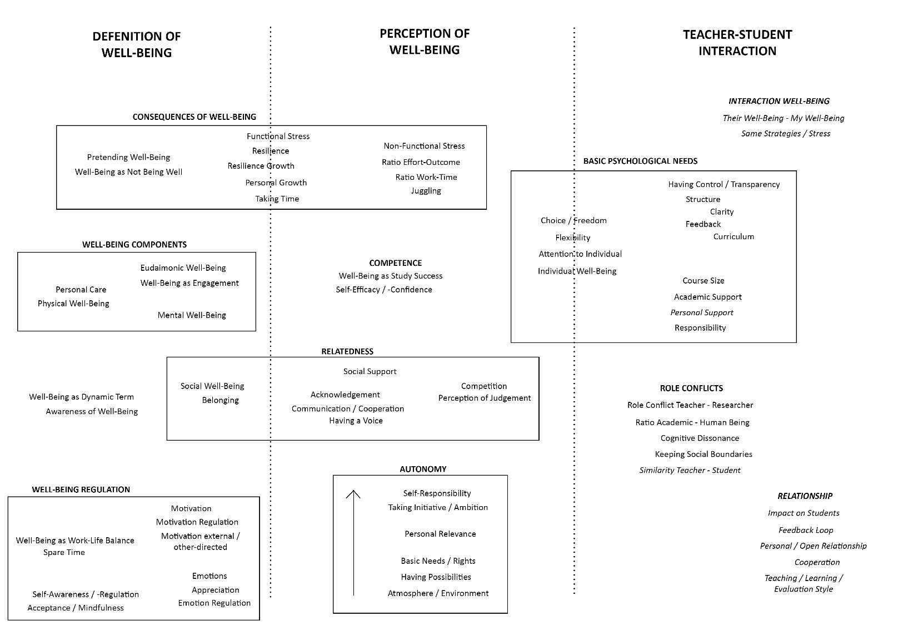
Results
Notes:
Lisa

Slide 11
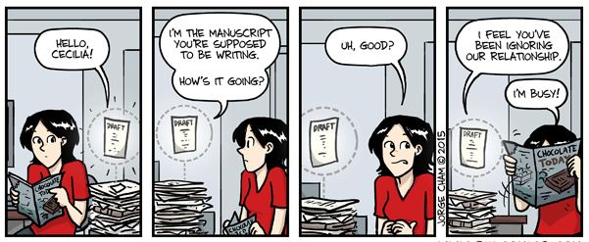
Questions
How to tackle writing the discussion section?
  Which topics to include?
  How to combine/ report?
Notes:
Together

Slide 12
Thanks for your attention!
Notes:
Together

Slide 13
Sources
Benbassat, J. (2014). Changes in wellbeing and professional values among medical undergraduate students: a narrative review of the literature. Advances in Health Sciences Education, 19(4), 597–610.
Bewick, B., Koutsopouloub, G., Miles, J., Slaad, E., & Barkham, M. (2010). Changes in undergraduate students’ psychological well-being as they progress through university. Studies in Higher Education, 35(6), 633–645.
Centers for disease control and prevention. (2018). Well-Being Concepts. https://doi.org/10.1097/01.phm.0000189841.18419.16
Cooke, R., Bewick, B. M., Barkham, M., Bradley, M., & Audin, K. (2006). Measuring, monitoring and managing the psychological well-being of first year university students. British Journal of Guidance and Counselling, 34(4), 505–517.
Deci, E. L., & Ryan, R. M. (2000). The “What” and "Why" of Goal Pursuits: Human Needs and the Self-Determination of Behavior. Psychological Inquiry, 11(4), 227–268.
Dyrbye, L., & Shanafelt, T. (2016). A narrative review on burnout experienced by medical students and residents. Medical Education, 50(1), 132–149.
Flaxman, P. E., Ménard, J., Bond, F. W., & Kinman, G. (2012). Academics' experiences of a respite from work: Effects of self-critical perfectionism and perseverative cognition on postrespite well-being. Journal of Applied Psychology, 97(4), 854.
Hagenauer, G., & Volet, S. (2014a). ‘I don’t think I could, you know, just teach without any emotion’: Exploring the nature and origin of university teachers’ emotions. Research Papers in Education, 29(2), 240-262.
Hagenauer, G., & Volet, S. E. (2014b). Teacher–student relationship at university: an important yet under-researched field. Oxford Review of Education, 40(3), 370-388.
Hogan, V., Hogan, M., & Hodgins, M. (2016). A study of workaholism in Irish academics. Occupational Medicine, 66(6), 460-465.
Kasser, T., & Ryan, R. M. (2001). Be careful what you wish for: Optimal functioning and the relative attainment of intrinsic and extrinsic goals. In Life goals and well-being: Towards a positive psychology of human striving (pp. 116–131).
Kordts-Freudinger, R. (2017). Feel, think, teach – Emotional Underpinnings of Approaches to Teaching in Higher Education. International Journal of Higher Education, 6, 217–229. doi:10.5430/ijhe.v6n1p217
Larcombe, W., Finch, S., Sore, R., Murray, C. M., Kentish, S., Mulder, R. A., … Williams, D. A. (2016). Prevalence and socio-demographic correlates of psychological distress among students at an Australian university. Studies in Higher Education, 41(6), 1074–1091.
Lundberg, C. A., & Schreiner, L. A. (2004). Quality and frequency of faculty-student interaction as predictors of learning: An analysis by student race/ethnicity. Journal of College Student Development, 45(5), 549-565.
Masten, A. S. (2001). Ordinary magic: Resilience processes in development. American Psychologist, 56(3), 227–238. https://doi.org/10.1037/0003-066X.56.3.227
Padilla, M. A., & Thompson, J. N. (2016). Burning out faculty at doctoral research universities. Stress and Health, 32(5), 551-558.
Panger, G., Tryon, J., & Smith, A. (2014). Graduate Student Happiness & Well-Being Report. https://doi.org/10.1016/j.jadohealth.2009.08.008
Postareff, L., & Lindblom-Ylänne, S. (2011). Emotions and confidence within teaching in higher education. Studies in Higher Education, 36(7), 799-813.
Reis, H. T., Gable, S. L., & Ryan, R. M. (2000). Daily Well-Being: The Role of Autonomy, Competence, and Relatedness. Personality and Social Psychology Bulletin, 26, 419–435.
Ryan, R. M., & Deci, E. L. (2011). A Self-Determination Theory Perspective on Social, Institutional, Cultural, and Economical Supports for Autonomy and Their Importance for Well-Being. In V. I. Chirkov, R. M. Ryan, & K. M. Sheldon (Eds.), Human Autonomy in Cross-Cultural Context. Perspectives on the Psychology of Agency, Freedom, and Well-Being (pp. 45–64). Springer Science+Business Media.
Schaufeli, W. B., Martínez, I. M., Pinto, A. M., Salanova, M., & Bakker, A. B. (2002). Burnout and Engagement in University Students. Journal of Cross-Cultural Psychology, 33(5), 464–481.
Seligman, M. E. P., & Csikszentmihalyi, M. (2000). Positive Psychology. American Psychologist, 55(1), 5–14.

Slide 14
Sources
Seligman, M. E. P., Forgeard, M. J. C., Jayawickreme, E., & Kern, M. L. (2011). Doing the right thing: Measuring well-being for public policy. International Journal of Wellbeing, 1(1). doi:10.5502/ijw.v1i1.15
Sheldon, K. M., Ryan, R. M., & Reis, H. T. (1996). What Makes for a Good Day? Competence and Autonomy in the Day and in the Person. Personality and Social Psychology Bulletin, 22(12), 1270–1279.Stallman, H. M. (2010). Psychological distress in university students: A comparison with general population data. Australian Psychologist, 45(4), 249–257.
Stallman, H. M. (2010). Psychological distress in university students: A comparison with general population data. Australian Psychologist, 45(4), 249–257. doi.org/10.1080/00050067.2010.482109
Stanton, A., Zandvliet, D., Dhaliwal, R., & Black, T. (2016). Understanding Students’ Experiences of Well-Being in Learning Environments. Higher Education Studies, 6(3), 90–
99. https://doi.org/10.5539/hes.v6n3p90
Strauss, L. C., & Volkwein, J. F. (2004). Predictors of student commitment at two-year and four-year institutions. The Journal of Higher Education, 75(2), 203-227.
Trigwell, K. (2012). Relations between teachers’ emotions in teaching and their approaches to teaching in higher education. Instructional Science, 40(3), 607-621.
Tugade, M. M., Fredrickson, B. L., & Feldman Barrett, L. (2004). Psychological Resilience and Positive Emotional Granularity: Examining the Benefits of Positive Emotions on Coping and Health. Journal of Personality, 72(6), 1161–1190.
Watts, J., & Robertson, N. (2011). Burnout in university teaching staff: a systematic literature review. Educational Research, 53(1), 33-50.
World Health Organization. (2020). Constitution. Retrieved May 10, 2020, from https://www.who.int/about/who-we-are/constitution
Wierenga, A., Landstedt, E., & Wyn, J. (2013). Revisiting disadvantage in higher education. Melbourne.
Winefield, A. H., Boyd, C., & Saebel, J. (2008). Job stress in university staff: An Australian research study. Australian Academic Press.
Zepke, N., & Leach, L. (2010). Improving student engagement: Ten proposals for action. Active Learning in Higher Education, 11(3), 167-177.

